Slide 1
Advanced SQL
Prof. Saed SAYAd

Slide 2
Advanced SQL
SQL Control-Flow Statements
Functions
Stored Procedures
Triggers
Cursors

Slide 3
1. SQL Control-Flow Statements
BEGIN TRANSACTION
BEGIN-END
IF-ELSE
WHILE-BREAK-CONTINUE
GOTO
RETURN
CASE
WAITFOR
TRY … CATCH
THROW

Slide 4
BEGIN TRANSACTION
Marks the starting point of an explicit, local transaction. Explicit transactions start with the BEGIN TRANSACTION statement and end with the COMMIT or ROLLBACK statement.
BEGIN TRANSACTION;
DELETE FROM JobCandidate
WHERE JobCandidateID = 13;
COMMIT;
BEGIN TRANSACTION
INSERT INTO [MyTable] VALUES (10248,100,'NY')
save transaction cp1
DELETE FROM [MyTable] WHERE OrderID = 10248
rollback transaction cp1
COMMIT
CREATE TABLE ValueTable (id int);
BEGIN TRANSACTION;
INSERT INTO ValueTable VALUES(1);
INSERT INTO ValueTable VALUES(2);
ROLLBACK;
TCL (Transaction Control Language)
SAVE TRANSACTION ‘CheckPoint1’

Slide 5
BEGIN-END
Encloses a series of SQL statements so that a group of SQL statements can be executed.
BEGIN
SELECT FirstName, MiddleName
FROM Person
WHERE LastName = 'Adams';
END;

Slide 6
IF-ELSE
Imposes conditions on the execution of a SQL statement.
The SQL statement that follows an IF keyword and its condition is executed if the condition is satisfied: the Boolean expression returns TRUE.
The optional ELSE keyword introduces another Transact-SQL statement that is executed when the IF condition is not satisfied: the Boolean expression returns FALSE.
IF-ELSE statements can be nested.
DECLARE @Number int;
SET @Number = 50;
IF @Number > 100
PRINT 'The number is large.';
ELSE
BEGIN
IF @Number < 10
PRINT 'The number is small.’;
ELSE
PRINT 'The number is medium.';
END ;
IF DATENAME(weekday, GETDATE()) IN ('Saturday', 'Sunday')
SELECT 'Weekend';
ELSE
SELECT 'Weekday';

Slide 7
WHILE-BREAK-CONTINUE
Sets a condition for the repeated execution of an SQL statement or statement block.
The statements are executed repeatedly as long as the specified condition is true.
The execution of statements in the WHILE loop can be controlled from inside the loop with the BREAK and CONTINUE keywords.
WHILE (SELECT AVG(ListPrice) FROM Product) < $300
BEGIN
UPDATE Production.Product SET ListPrice = ListPrice * 2
SELECT MAX(ListPrice) FROM Product
IF (SELECT MAX(ListPrice) FROM Product) > $500
BREAK
ELSE
CONTINUE
END
PRINT 'Too much for the market to bear';

Slide 8
GOTO
Alters the flow of execution to a label.
The SQL statement or statements that follow GOTO are skipped and processing continues at the label.
GOTO statements and labels can be used anywhere within a procedure, batch, or statement block.
GOTO statements can be nested.
DECLARE @Counter int;
SET @Counter = 1;
WHILE @Counter < 10
BEGIN
SELECT @Counter
SET @Counter = @Counter + 1
IF @Counter = 4 GOTO Branch_One
IF @Counter = 5 GOTO Branch_Two
END
Branch_One:
SELECT 'Jumping To Branch One.'
GOTO Branch_Three;
Branch_Two:
SELECT 'Jumping To Branch Two.'

Slide 9
RETURN
Exits unconditionally from a query or procedure.
RETURN is immediate and complete and can be used at any point to exit from a procedure, batch, or statement block.
Statements that follow RETURN are not executed.
CREATE PROCEDURE checkstate
AS
IF (SELECT count(*) FROM Products) > 0
RETURN 1
ELSE
RETURN 2;
GO
declare @valback int
exec @valback = checkstate
select @valback

Slide 10
CASE
CASE-[WHEN-THEN]-ELSE-END provides a structured method of evaluating a list of options and then returning a single value.
SELECT ProductNumber, Name, Price_Range =
CASE
WHEN ListPrice = 0 THEN 'Mfg item - not for resale'
WHEN ListPrice < 50 THEN 'Under $50'
WHEN ListPrice >= 50 and ListPrice < 250 THEN 'Under $250'
WHEN ListPrice >= 250 and ListPrice < 1000 THEN 'Under $1000'
ELSE 'Over $1000'
END
FROM Product
ORDER BY ProductNumber ;

Slide 11
WAITFOR
Blocks the execution of a batch, stored procedure, or transaction until a specified time or time interval is reached.
BEGIN
WAITFOR DELAY '02:00';
EXECUTE sp_helpdb;
END;
BEGIN
WAITFOR TIME '22:20';
EXECUTE sp_update_job @job_name = 'TestJob'
END;

Slide 12
TRY … CATCH
Implements error handling for SQL that is similar to the exception handling in the Microsoft Visual C# and Microsoft Visual C++ languages.
A group of SQL statements can be enclosed in a TRY block. If an error occurs in the TRY block, control is passed to another group of statements that is enclosed in a CATCH block.
BEGIN TRY
-- Generate divide-by-zero error.
SELECT 1/0;
END TRY
BEGIN CATCH
SELECT ‘Divide by Zero’
END CATCH;

Slide 13
RAISERROR & THROW
Raises an exception and transfers execution to a CATCH block of a TRY…CATCH construct.
RAISERROR (15600, ‘Duplicate Record!', 16, 10);
THROW 51000, 'The record does not exist.', 1;
State
Is an integer from 0 through 255. Negative values default to 1. Values larger than 255 should not be used.
If the same user-defined error is raised at multiple locations, using a unique state number for each location can help find which section of code is raising the errors.
Severity levels from 20 through 25 are considered fatal. If a fatal severity level is encountered, the client connection is terminated after receiving the message, and the error is logged in the error and application logs.

Slide 14
Differences Between RAISERROR and THROW
RAISERROR statement | THROW statement
If a msg_id is passed to RAISERROR, the ID must be defined in sys.messages. | The error_number parameter does not have to be defined in sys.messages.
The msg_str parameter can contain printf formatting styles. | The message parameter does not accept printf style formatting.
The severity parameter specifies the severity of the exception. | There is no severity parameter. The exception severity is always set to 16.

Slide 15
2. SQL Functions
User can create functions in SQL Server for saving the SQL statements permanently in the system.
The functions are calls as User Defined Functions (UDF).
A UDF is the database object that contains a set of SQL statements.
The function accepts input as parameters, performs actions and the result set is returned as action. The return value can be a result set or a single value.
Scalar functions returns one value and Table-valued functions returns a table of results.

Slide 16
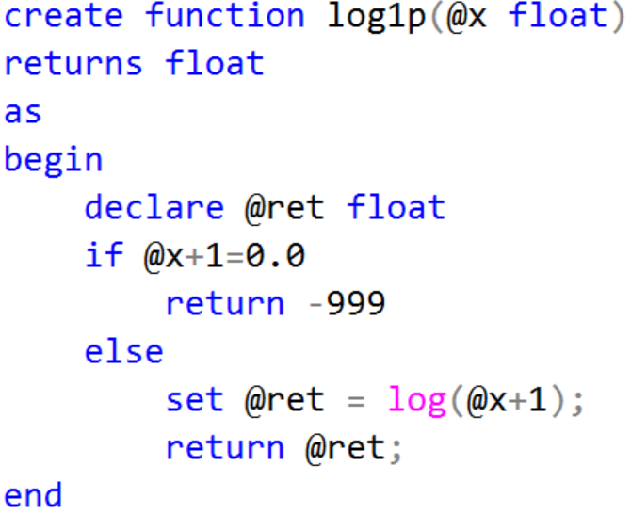
Create Function - Scalar

Slide 17
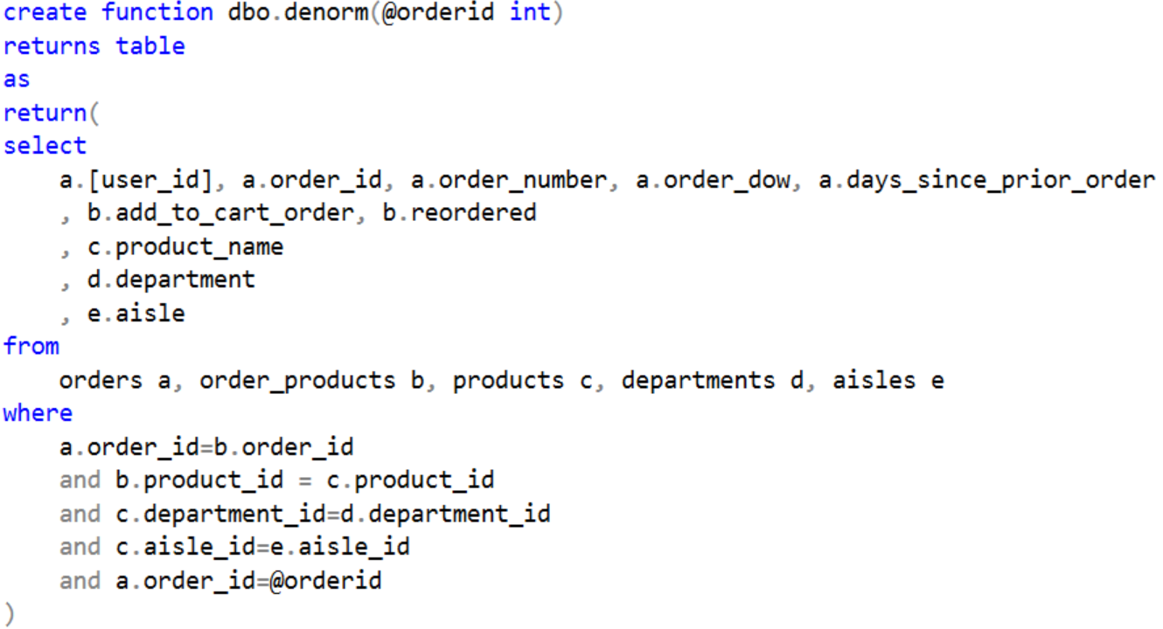
Create Function - Table

Slide 18
3. Stored Procedures
If you find yourself using the same query over and over again, it would make sense to put it into a stored procedure.
A stored procedure is an already written SQL statement that is saved in the database.
When you put this SQL statement in a stored procedure, you can then run the stored procedure from the database’s command environment using the exec command.
Like a function, a stored procedure can be used to perform a calculation.
Like a view, a stored procedure can be used to create and store a query.

Slide 19
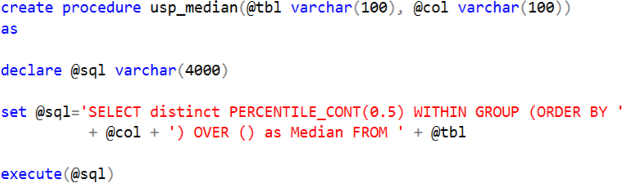
Stored Procedures – Example 1

Slide 20
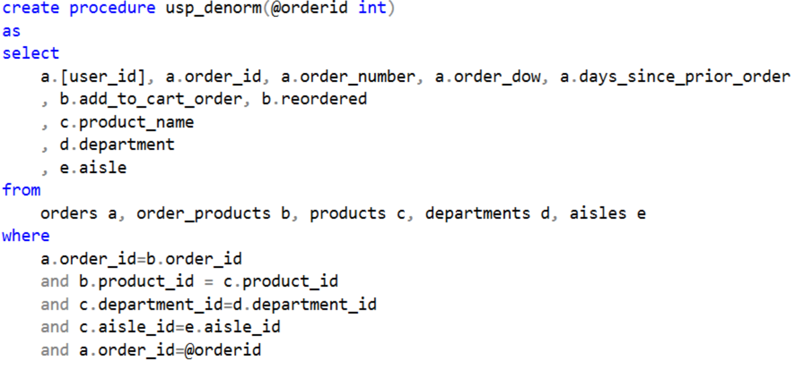
Stored Procedure – Example 2

Slide 21
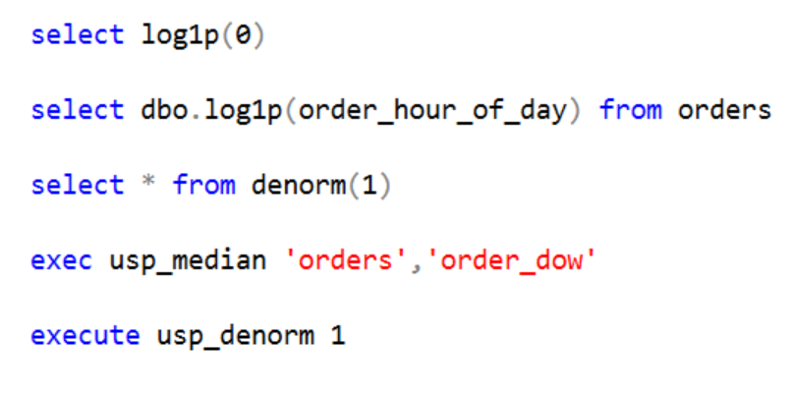
Examples

Slide 22
4. SQL Triggers
A SQL trigger is a special type of stored procedures that is automatically executed when an event occurs in a specific database server (Event-Condition-Action)
Triggers and Stored Procedures are SQL statements. However, a stored procedure has to be executed by a user, while a trigger is executed by the system as the result of an event
Events that cause triggers to be activated include insert, update, delete, create, alter and drop.
One drawback to using triggers instead of stored procedures is that they cannot accept parameters.

Slide 23
DDL Triggers
A DDL trigger will be fired in response to different Data Definition Language (DDL) events, such as CREATE, ALTER, DROP T-SQL statements
Trigger Name
CREATE TRIGGER safety
ON DATABASE
FOR DROP_TABLE, ALTER_TABLE
AS
PRINT 'You must disable Trigger "safety" to drop or alter tables!'
ROLLBACK;
Events
Target
Actions

Slide 24
DML Triggers
A DML trigger will be fired in response to different Data Manipulation Language (DML) events, such as INSERT, UPDATE or DELETE action
The DML triggers can be used to maintain data integrity and enforce business rules by performing auditing processes and other post DML actions.
Trigger Name
CREATE TRIGGER reminder1
ON Products
AFTER INSERT, UPDATE
AS
RAISERROR ('Notify Management', 16, 10);
Timing
Target
Events
Actions

Slide 25
SQL Triggers Syntax
Trigger name - unique within one database schema
Timing - depends on the order of controlled events (before or after or instead of)
Triggering event - event which fires the trigger (E)
Filtering condition - checked when the triggering event occurs (C)
Target - table (or view) against which the trigger is fired; they should be both created within the same schema
Trigger action - SQL statements, executed when the trigger fires; surrounded by Begin ... End (A)

Slide 26
Types of SQL Triggers
How many times should the trigger body execute when the triggering event takes place?
Per statement: the trigger body executes once for the triggering event. This is the default.
For each row: the trigger body executes once for each row affected by the triggering event.
When the trigger can be fired
Relative to the execution of an SQL DML statement (before or after or instead of)
Exactly in a situation depending on specific system resources (e.g. signal from the system clock, expiring timer, exhausting memory)

Slide 27
Trigger Execution Order
Execute all BEFORE STATEMENT triggers
Disable temporarily all integrity constraints recorded against the table
Loop for each row in the table
Execute all BEFORE ROW triggers
Execute the SQL statement against the row and perform integrity constraint checking of the data
Execute all AFTER ROW triggers
Complete deferred integrity constraint checking against the table
Execute all AFTER STATEMENT triggers

Slide 28
Timing - INSTEAD OF
An INSTEAD OF trigger is a trigger that allows you to skip an INSERT, DELETE, or UPDATE statement to a table or a view and execute other statements defined in the trigger instead. The actual insert, delete, or update operation does not occur at all.
CREATE TRIGGER trigger_delete
ON Products
INSTEAD OF DELETE
AS
BEGIN
UPDATE a
SET a.Discontinued=1
FROM Products a, deleted b
WHERE a.ProductID=b.ProductID
END

Slide 29
DROP, DISABLE and ENABLE Triggers
DDL
DML
DROP TRIGGER safety ON DATABASE;
DROP TRIGGER reminder1;
DISABLE TRIGGER safety ON DATABASE;
DISABLE TRIGGER reminder1 ON Products;
ENABLE TRIGGER safety ON DATABASE;
ENABLE TRIGGER reminder1 ON Products;

Slide 30
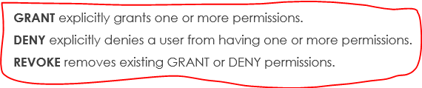
Triggers - Rules for Good Practice
Rule 1: Do not change data in the primary key, foreign key, or unique key columns of any table
Rule 2: Do not update records in the same table you read during the same transaction
Rule 3: Do not aggregate over the same table you are updating
Rule 4: Do not read data from a table which is updated during the same transaction
Rule 5: Do not use SQL DCL (Data Control Language) statements in triggers

Slide 31
5. SQL Cursors
Operations in a relational database act on a complete set of rows.
For example, the set of rows returned by a SELECT statement consists of all the rows that satisfy the conditions in the WHERE clause of the statement.
This complete set of rows returned by the statement is known as the result set.
Applications, especially interactive online applications, cannot always work effectively with the entire result set as a unit. These applications need a mechanism to work with one row or a small block of rows at a time.
Cursors are an extension to result sets that provide that mechanism.

Slide 32
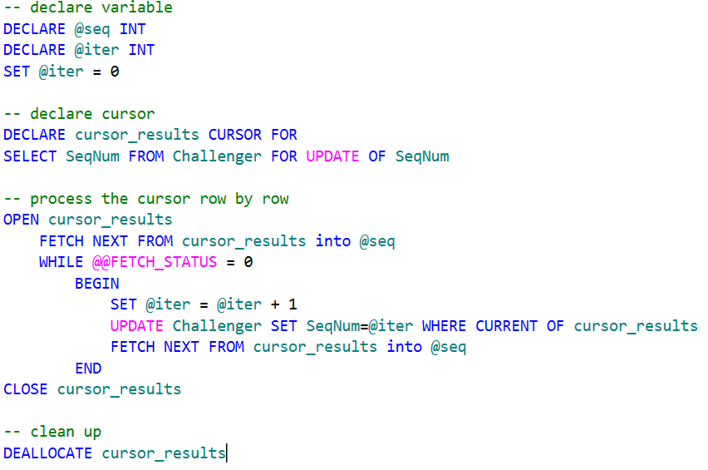
SQL Cursors – Example

Slide 33
References
P. Atzeni, S. Ceri, S.Paraboschi and R. Torlone. Database Systems, Chapter 12 “Active Databases”. McGraw-Hill (1999)
Oracle Database Server Documentation. Oracle9i Database Concepts, Chapter 17 “Triggers”.
Oracle Database Server Documentation. Oracle9i Application Developer's Guide – Fundaments, Chapter 15 “Using Triggers”.
http://computing.unn.ac.uk/staff/cgma2/cm036/Week2/Triggers.ppt
https://codingsight.com/sql-server-triggers-understanding-alternatives/

